Slide 1
Strategic and Change Management
Presented by
Dennis Smith
02/04/2016

Slide 2
What is Culture?
Values, norms, guiding beliefs, and understandings that are shared by members of an organization
Taught to new members as the correct way to think, feel, and behave
Organizational culture exists at two levels
Observable symbols
Underlying values
©2013 Cengage Learning. All Rights Reserved. May not be scanned, copied or duplicated, or posted to a publicly accessible website, in whole or in part.

Slide 3
Definition of Organisational Culture
Schein (1990:111) provides one of the most widely quoted definitions of organisation culture as “
a pattern of basic assumptions,
invented, discovered, or developed by a given group, …
as it learns to cope with its problems of external adaptation and internal integration,….
that has worked well enough to be considered valid and, therefore …
is to be taught to new members as the ….
correct way to perceive, think, and feel in relation to those problems.”

Slide 4
Lundberg has painstakingly constructed a combination of the major themes that are contained in numerous definitions and has put forward a possible consensus reflection of Organisational Culture:
“It is a shared, common frame of reference,
i.e., it is largely taken for granted and is shared by a significant portion of organisation members
it is acquired and governs,
i.e., it is socially learned and transmitted by members and provides them with rules for their organisational behaviour
it endures over time,
i.e., it can be found in any fairly stable social unit of any size, as long as it has a reasonable history
it is symbolic,
i.e., it is manifested in observable things such as language, behaviour, and things to which we attribute meanings
it is at its core typically invisible and determinant,
i.e., it is ultimately comprised of a configuration of deeply buried values and assumptions it is modifiable, but not easily so.

Slide 5
Other definitions of corporate culture are listed below:
Observed behavioural regularities when people interact
The norms that evolve in working groups
The dominant values espoused by an organisation
The philosophy that guides an organisation’s policies
The rules of the game for getting along in the organisation
A system of shared values in an organisation
A system of shared meaning in an organisation
The way we do things around here

Slide 6
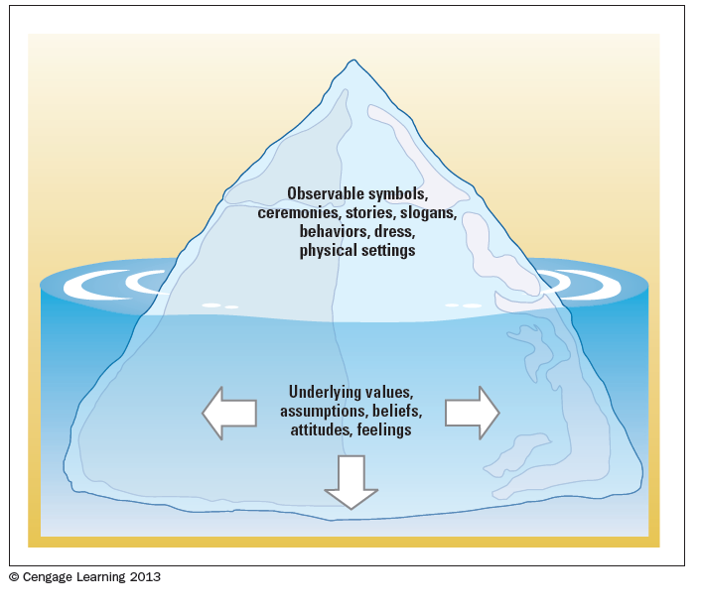
Levels of Corporate Culture
©2013 Cengage Learning. All Rights Reserved. May not be scanned, copied or duplicated, or posted to a publicly accessible website, in whole or in part.

Slide 7
Emergence and Purpose of Culture
Provides sense of organizational identity
Two critical functions in organizations:
To integrate members so they know how to relate to one another
To help organization adapt to external environment
Internal Integration – collective identity and know how to work together
External Adaption – how the organization meets goals and deals with outsiders
©2013 Cengage Learning. All Rights Reserved. May not be scanned, copied or duplicated, or posted to a publicly accessible website, in whole or in part.

Slide 8
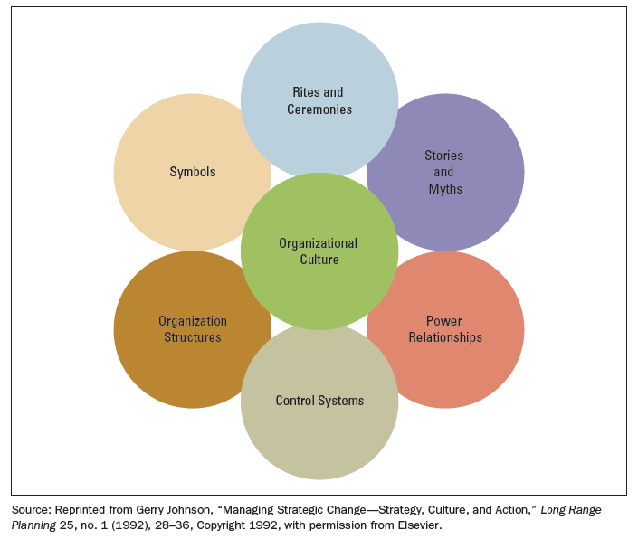
Observable Aspects of Organizational Culture
©2013 Cengage Learning. All Rights Reserved. May not be scanned, copied or duplicated, or posted to a publicly accessible website, in whole or in part.

Slide 9
Culture Strength and Organizational Subcultures
Culture strength is the degree of agreement among members of an organization about specific values
Subcultures reflect the common problems, goals, and experiences of a team or department
Different departments may have their own norms
©2013 Cengage Learning. All Rights Reserved. May not be scanned, copied or duplicated, or posted to a publicly accessible website, in whole or in part.

Slide 10
Organizational Culture, Learning, and Performance
Culture is important to learning and innovation during challenging times
Strong adaptive cultures often incorporate the following values:
The whole is more important than the parts
Equality and trust are primary values
The culture encourages risk taking, change, and improvement
©2013 Cengage Learning. All Rights Reserved. May not be scanned, copied or duplicated, or posted to a publicly accessible website, in whole or in part.

Slide 11
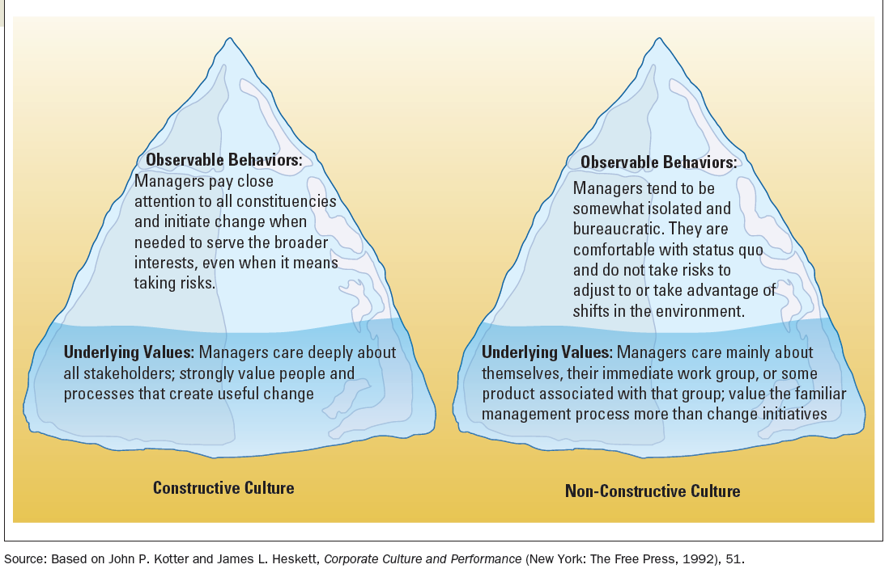
Constructive Versus Non-Constructive Cultures
©2013 Cengage Learning. All Rights Reserved. May not be scanned, copied or duplicated, or posted to a publicly accessible website, in whole or in part.

Slide 12
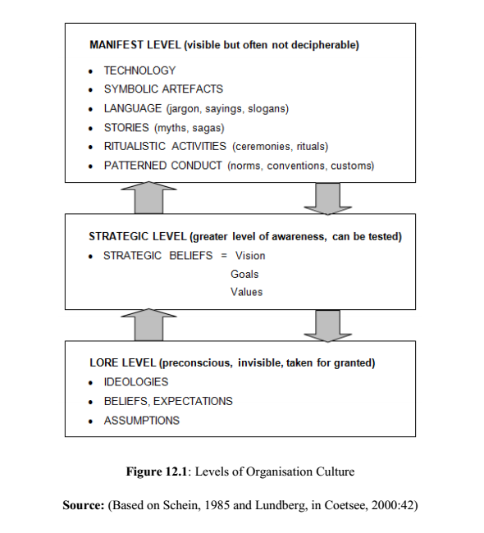

Slide 13
Ethical Values and Social Responsibility
Ethics
Ethics refer to the code of moral principles and values that govern the behaviors of a person or group with respect to what is right or wrong
Managerial Ethics
Ethical decisions go far beyond behaviors governed by law
Managerial ethics guide the decisions and behaviors of managers
©2013 Cengage Learning. All Rights Reserved. May not be scanned, copied or duplicated, or posted to a publicly accessible website, in whole or in part.

Slide 14

Creating and Sustaining Organizational Culture
Cultural Symbols
Company Rituals and Ceremonies
Company Heroes
Stories
Language
Organizational Policies and Decision Making
Leadership
McGraw-Hill
© 2004 The McGraw-Hill Companies, Inc. All rights reserved.

Slide 15
The following elements are important in creating and sustaining an organisation's culture (Coetsee, 2000: 56): Primary Mechanisms:
What leaders pay attention to, measure and control.
How leaders react to critical incidents and organisational crises.
Deliberate role modelling and coaching.
Operational criteria for allocating rewards and status.
Operational criteria for recruitment, selection, promotion, retirement and excommunication.
Secondary Articulation and Reinforcement Mechanisms:
The organisation’s design and structure.
Organisational systems and procedures.
Design of physical spaces, facades and symbols.
Formal statements of organisation philosophy, convictions, strategies (i.e. vision, mission and values)

Slide 16
Corporate Culture and Corporate Effectiveness
A strong culture is marked by the organisation's essential values being powerfully stated, clearly organised, and broadly shared.
Corporate Culture, in a very profound sense, provides the organisation with answers to issues such as survival in its external environment, while effectively managing and regulating its internal affairs.
This embodies handling crises, inducting new members, defining and measuring satisfactory performance, and motivating members of staff while maintaining morale. In a broader sense, the culture assists in making decisions to do with the growth or decline of the organisation and adding or removing products and services.
The culture assists members in their individual decision making by incorporating that which has been found to work consistently over time and which can be effectively expressed and maintained through symbolic and patterned behaviours and devices that serve as a guide for future actions.

Slide 17
Situated at the core of the organisation’s key objectives, culture provides the sustaining reasons and rationale for its vision, mission, strategy and philosophies - and provides the raison d'être for all of its activities and commitments.
Corporate culture, then, is the foundation of an organisation’s identity and also …
the basis for order, direction and cohesion in setting and … understanding its goals (“where we want to be”),….
its activities (“how are we going to get there”) and ….
its behaviour (“how we do things”), and how they are related to each other.

Slide 18
Changing Corporate Culture
Changing an organisation’s culture and climate is often related to the implementation of a new strategic direction that the organisation wishes to follow.
Changing the climate cannot be done directly since climate represents an amalgam of perceptions, attitudes and expectations.
In other words, climate should be seen as a result or output; so efforts to influence climate must be directed ‘upstream’ at areas such as the
organisation’s processes and structures, including communication, decision-making, co-ordination of goals and objectives, the motivating climate and the quality of the physical work environment and,
finally, top management’s interest in the wellbeing of employees and organisation members.

Slide 20
general guidelines for bringing about significant changes to an organisation's culture (Miller, 1998: 376-377):
1. Understand the current culture so you know where you stand. If necessary, perform an extensive cultural audit.
2. Avoid head-on confrontation with the old guard if at all possible.
3. Change the management leadership. A gradual shift may be appropriate, or top executives may have to “clean house” and bring in all new managers.
4. While vision statements can be important, don’t count on them alone to bring about cultural change. Words become empty and hypocritical if those using them neglect to change their own behaviour. Leaders must “live the new culture”.
5. Create new organisation folklore. The definition of myth is “a fictional tale that offers insight into a deeper truth.” Organisations help themselves understand who they are by the stories they tell one another about themselves.
6. Use symbols to instil new thinking. Symbols often become the subject ofnew organisational folklore and myths

Slide 21
Organisation Climate
Organisation Climate is less encompassing than culture and is also more readily measured.
It is closely related to culture in that it is a measure of people’s expectations of what it should be like to work for an organisation, and the degree to which these expectations are met.
What it really measures is the fit between the prevailing culture and the individual values of the employee. If the employees have adopted values of the prevailing culture, the fit is good. If not, the fit is poor and motivation and performance will suffer (Hax & Majluf, 1984: 99).
French, Kast and Rosenweig (1985: 532) define organisational climate as
“. . . The relatively persistent set of perceptions held by organisation members concerning the characteristics and quality of the organisational culture.”
Climate, then, is another means of gauging culture down to the level of Schein’s preconscious values.

Slide 22
Stages of the Socialization Process
Pre-arrival
Encounter
Metamorphosis
McGraw-Hill
© 2004 The McGraw-Hill Companies, Inc. All rights reserved.

Slide 23
Organisation Climate cont.
Likert and Likert identified four basic types of organisations which they dubbed
Authoritative,
Benevolent- Authoritative,
Consultative, and, finally,
Participative-Group.
Because of the emotive connotations evoked by these labels, they later changed them simply to be System One, System Two, System Three and System Four.
Note that each system is described along six key dimensions:
Leadership,
Motivation,
Communication,
Decisions,
Goals and, finally,
Controls.

Slide 24
Characteristics and Types of Organizational Culture (continued)
Types: Traditional Control or Employee Involvement
Traditional control
emphasizes the chain of command
relies on top-down control and orders
Employee involvement
emphasizes participation and involvement
McGraw-Hill
© 2004 The McGraw-Hill Companies, Inc. All rights reserved.

Slide 25
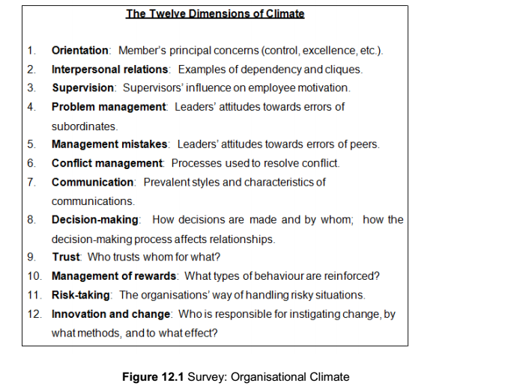
Pariek in 1989 (Coetsee, 2000 : 47-48) :

Slide 26
Practical Application of Organisation Climate Models
The dimensions of climate and their sub-factors are commonly used in instruments and surveys of organisational climate to gauge an organisation’s climate, either as an independent exercise or as part of a larger OD intervention.
There are a number of ways that managers and change consultants can apply organisational climate models and measurement techniques

Slide 27
These may include:
Putting together a system to gather and keep reliable historical data on a regular basis, to supplement other measures of effectiveness
Creating a diagnostic tool to measure the so-called “soft issues” of effective organisational functioning including before and after measures of organisational change programmes
Broadening the diagnostic applications to include the results and effects of planned changes on the organisation’s vision, mission, strategies, technologies, methods, and practices
Highlighting the differences among sub-units and sections of the organisation including the subcultures that have evolved in terms of the specific management styles and practices, remuneration policies and procedures, and finally, the communication and decision- making techniques that differentiate them
finally, organisational climate complements and expands Systems Theory by providing a means for managers or consultants to broaden their focus from individuals to groups and other organisational systems.
The concept of organisational climate provides an orderly, theoretical framework for examining and for planning and attempting to influence the behaviour of work groups within the ambit of an open systems environment.

Slide 28
Organisation Climate and Organisational Effectiveness
Climate is closely related to Culture in that it is a measure of people’s expectations of what it should be like to work for an organisation, and the degree to which these expectations are met.
We can therefore assume that the strength of the culture will also reflect directly on the relationship between climate and organisational effectiveness.
An organisation’s climate is made up of the perceptions, feelings and attitudes of the organisation’s members towards the organisation.
Perceptions, feelings and attitudes can be incorrect and incomplete.
Nevertheless, for the individuals concerned, their perceptions represent the truth. It is, therefore, immaterial whether perceptions are correct and complete.
If perceptions exist, they constitute reality in the mind of the individual and irrespective whether it is the truth or not, they should be addressed as if it was the complete truth

Slide 29
against this backdrop of perceived reality, therefore, that the effective application of the popular motivational models must be applied in an organisational context,
whether the motivational model is Maslow, Herzberg, Alderfer, McClelland,
McGregor, MBO, Theory Y, Theory Z, Job Enlargement, Job Enrichment, or
whatever.
Ultimately, the motivational climate that the organisation is able to establish will also be the perceived reality of its members.
It is in the interest of the organisation and all its members that a positive and constructive climate exists.
Therefore, it is necessary to audit and measure an organisation’s climate often, and to take the necessary actions to improve it on a regular basis

Slide 31
Leadership

Slide 32
What is leadership?
Leading people
Influencing people
Commanding people
Guiding people

Slide 33
Leadership Defined
“Leadership is an influence relationship among leaders and followers who intend real changes and outcomes that reflect their shared purposes” (Daft, 2015: 8).
Leadership involves influence, change, shared purpose, intentions, followers, and personal responsibility and integrity (Daft, 2015: 5)
“Hierarchy has nothing to do with reporting to each other. It has everything to do with creating a value stream, where managers bring value to problem-solving and decision-making of their teams” (Foster, 2015: 92).
Managers’ success depends on their capacity to lead, support, and provide resources so subordinates are able to accomplish their goals.

Slide 34
Organisational Structures, Technology and Leadership
Today’s new horizontal organisational structures make
Jaques’ time-span theory of hierarchy more important than ever before.
Jaques argued that the higher a person was positioned in a hierarchy, assuming the individual possessed a corresponding level of cognitive complexity, acquired skills and knowledge (gained through experience) and presuming that individual valued the work he or she was tasked, the longer he could work to complete a task without supervision. The time span of a CEO of a major institution might be 15–20 years. This concept enabled him to describe a "requisite organization" as one in which each level in the hierarchy had its own distinctive time span. If an organization had too many levels, then their time spans overlapped. If a manager at a higher level was ill equipped in respect of his or her inherent mental processing capability, or lacked the required skills and knowledge the risk is they would interfere in the work of managers at a lower level generally propelled by their own anxiety and insecurity. The process of delegation would be undermined leading to organizational dysfunction.
Emotional Intelligence and Leadership “Emotional intelligence refers to a person’s abilities to perceive, identify, understand and successfully manage emotions in self and others” (Daft, 2015: 146).

Slide 35
Leadership and Management
2008 Gallup poll on honesty and ethics among workers in 21 different professions :
only 12% felt business executives had high/very high integrity – an all-time low.
37% rate executives low/very low on integrity.
2009 survey by Management Today:
31% of respondents stated they had low or no trust in their management team. 2007/8 Global Workforce survey of Tower Perrin polled 90 000 workers in 18 countries: Only 21% were truly engaged in their work in the sense that they would “go the extra mile” for their employer
The 2013 Edelman Trust Barometer highlights a crisis in leadership.
Only 15% of people in the U.S. believe business leaders will tell the truth when confronted with a difficult issue.
Low trust causes toxic teams, and toxic teams kill employee engagement! This pattern is continuously confirmed by MBA students during class discussions.
Everybody is interested in leadership, but how do we break the patterns from the past? How do we restore confidence in leaders and their practice?

Slide 36
Leadership challenge # 1 – To learn To accept that the paradigms, mental models and business approaches of the past is not going to be the route to future success. To practice a wider spectrum of leadership styles, given the complexity of our context.

Slide 37
An abundance perspective on leadership
Leadership does not only reside in a “super-club” of specially gifted individuals or the executive floor.
Organisational success is the result of many collaborators each doing their part to fulfil shared ideals and aspirations of the enterprise. In thriving organisations, leaders and leadership behaviour is an ubiquitous, widely distributed capability.
The reality is that there are people who swim in front.
Leadership cannot exist without followers. Followers always “swim” behind a leader/s, but in front of others.
This implies that, paradoxically, we are ALL leaders and followers at the same time. To be a leader is however a conscious choice.
We are all confronted with this challenge choice. To lead from anywhere requires a systematic on-going skills building approach

Slide 38
How do we see leadership?
Leadership is viewed from an outcome perspective.
Leadership is not about our intent, but all about our effect on others.
We know leaders are judged by their results as well as how it was achieved and not their intent only.
Leadership is a capability to influence positively and impact on situations and people in order to make a difference in the circle of influence of the leader and her or his followers.
Leaders exert their influence and power in such a way that they impact the status quo and others in a positive way.
Leadership is a team activity where mutual influencing between leaders and followers creates outcomes that no individual could have achieved on her or his own.
The core activity that leaders perform is to use their voice, presence and power ethically and within moral boundaries to energise themselves and others

Slide 39
Authentic leadership in the context of leadership models
Virtues as our moral compass
“Seven social sins:
Politics without principles,
Wealth without work,
Pleasure without conscience,
Knowledge without character,
Commerce without morality,
Science without humanity, and
Worship without sacrifice."

Slide 40
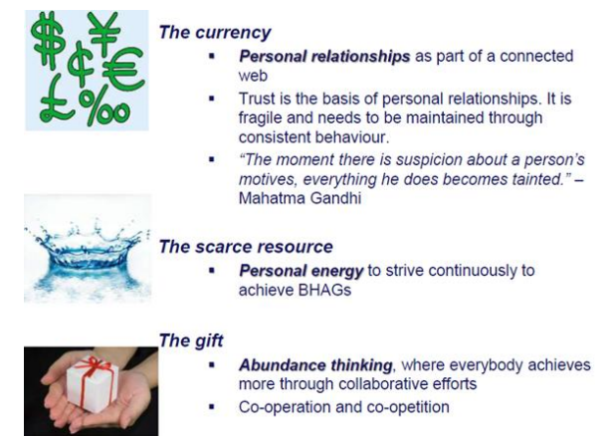
Figure 13.1: Leading in the 21st Century

Slide 41
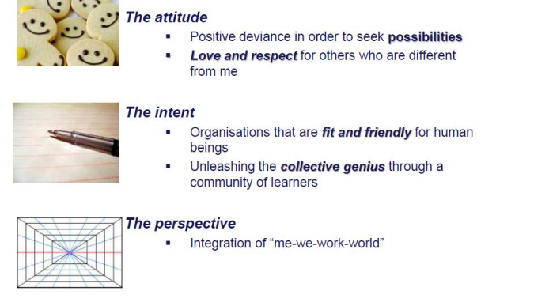
Figure 13.1: Leading in the 21st Century

Slide 42
We can all choose to be great leaders!
Greatness comes with recognising that your potential is limited only by:
how you choose,
how you use your freedom,
how resolute you are,
how persistent you are
– in short, by your attitude. And we are all free to choose our attitude.

Slide 43
The Myths about leadership
Long live the hero leader
Leadership power is all about me
Leadership is about a position
Leadership is only about results
Leadership is just another additional task
Leadership deals only with the positive things in life

Slide 44
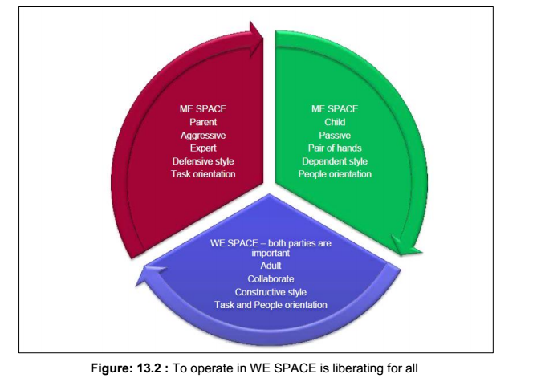

Slide 45
Types of Leaders
Leader by the position achieved
Leader by personality, charisma
Leader by moral example
Leader by power held
Intellectual leader
Leader because of ability to accomplish things

Slide 46
Managers vs. Leaders
Managers
Focus on things
Do things right
Plan
Organize
Direct
Control
Follows the rules
Leaders
Focus on people
Do the right things
Inspire
Influence
Motivate
Build
Shape entities

Slide 47
Common Activities
Planning
Organizing
Directing
Controlling

Slide 48
Planning
Leader
Devises strategy
Sets direction
Creates vision
Manager
Planning
Budgeting
Sets targets
Establishes detailed steps
Allocates resources

Slide 49
Organizing
Manager
Creates structure
Job descriptions
Staffing
Hierarchy
Delegates
Training
Leader
Gets people on board for strategy
Communication
Networks

Slide 50
Directing Work
Manager
Solves problems
Negotiates
Brings to consensus
Leader
Empowers people
Cheerleader

Slide 51
Controlling
Manager
Implements control systems
Performance measures
Identifies variances
Fixes variances
Leader
Motivate
Inspire
Gives sense of accomplishment

Slide 52
Leadership Traits
Intelligence
More intelligent than non-leaders
Scholarship
Knowledge
Being able to get things done
Physical
Doesn’t see to be correlated
Personality
Verbal facility
Honesty
Initiative
Aggressive
Self-confident
Ambitious
Originality
Sociability
Adaptability

Slide 53
Leadership Styles
Delegating
Low relationship/ low task
Responsibility
Willing employees
Participating
High relationship/ low task
Facilitate decisions
Able but unwilling
Selling
High task/high relationship
Explain decisions
Willing but unable
Telling
High Task/Low relationship
Provide instruction
Closely supervise

Slide 54
New Leaders Take Note
General Advice
Take advantage of the transition period
Get advice and counsel
Show empathy to predecessor
Learn leadership
Challenges
Need knowledge quickly
Establish new relationships
Expectations
Personal equilibrium

Slide 55
New Leader Traps
Not learning quickly
Isolation
Know-it-all
Keeping existing team
Taking on too much
Captured by wrong people
Successor syndrome

Slide 56
Seven Basic Principles
Have two to three years to make measurable financial and cultural progress
Come in knowing current strategy, goals, and challenges. Form hypothesis on operating priorities
Balance intense focus on priorities with flexibility on implementation….

Slide 57
Seven Basic Principles, con’t
Decide about new organization architecture
Build personal credibility and momentum
Earn right to transform entity
Remember there is no “one” way to manage a transition

Slide 58
Core Tasks
Create Momentum
Master technologies of learning, visioning, and coalition building
Manage oneself

Slide 59
Create Momentum
Learn and know about company
Securing early wins
First set short term goals
When achieved make a big deal
Should fit long term strategy
Foundation for change
Vision of how the organization will look
Build political base to support change
Modify culture to fit vision

Slide 60
Create Momentum
Build credibility
Demanding but can be satisfied
Accessible but not too familiar
Focused but flexible
Active
Can make tough calls but humane

Slide 61
Master Technologies
Learn from internal and external sources
Visioning - develop strategy
Push vs. pull tools
What values does the strategy embrace?
What behaviors are needed?
Communicate the vision
Simple text - Best channels
Clear meaning - Do it yourself!

Slide 62
Enabling Technologies, con’t
Coalition building
Don’t ignore politics
Technical change not enough
Political management isn’t same as being political
Prevent blocking coalitions
Build political capital

Slide 63
Manage Oneself
Be self-aware
Define your leadership style
Get advice and counsel
Advice is from expert to leader
Counsel is insight
Types of help
Technical
Political
Personal
Advisor traits
Competent
Trustworthy
Enhance your status

Slide 64
Today’s leaders must create a corporate culture that is forward-thinking— encouraging their followers to constantly learn, and stay abreast of the changing times.
This is a 21st century leadership imperative. An empowered team with tremendous group knowledge will drive organisations towards prosperous futures.

Slide 65
How Far Can You Go?

Slide 66
Thank You
and
Best Wishes

